Slide 1
Leading and misleading the reader: ethical issues of technical communication

Slide 2
Ethics
Ethics refers the moral principles guiding an individual's behavior in the pursuit of activities.
It contains regulating, defending, and recommending concepts of right and wrong conducts
Ethics concerns matters of value comprising the branch of philosophy called axiology.
Ethics seeks to resolve questions of human morality by defining concepts such as good and evil, right and wrong, virtue and vice, justice and crime.

Slide 3
Ethical Principles
1. Legality: Following rules and regulations relevant to your actions or industry
A company follows tax laws by accurately reporting earnings and paying taxes on time.
2. Honesty: Being truthful and transparent in your actions and communications
A salesperson exactly describing a product's features and limitations rather than exaggerating.
3. Confidentiality: Protecting private or sensitive information from unauthorized access
A doctor protecting a patient’s medical records and not sharing them without consent.
4. Quality: Striving to provide high standards in products, services, or work output.
An engineer ensuring that a bridge design meets all safety standards and specifications to guarantee durability and safety.
5. Professionalism: Upholding a high standard of behavior, respect, and expertise in workplace.
A project manager manages deadlines and conflicts tactfully maintaining respect and integrity toward their team members.

Slide 4
Major Ethical Considerations
1. Objectivity: Making decisions and judgments based on facts and evidence without personal bias or prejudice.
2. Plagiarism: Using someone else’s work, ideas, or words without proper acknowledgment, presenting them as your own.
3. Manipulation of Information: Altering or misrepresenting information to deceive/ mislead others.
4. Conflict of Interest: A situation where personal interests might interfere with professional duties.
5. Theft of Copyrighted Information: Using copyrighted material without permission or violating intellectual property rights.
6. Privacy: Respecting and protecting individuals' personal information and data.
A company securing customer data to prevent unauthorized access or breaches.
7. Respect to Others: Treating others with dignity, courtesy, and fairness

Slide 5
Ethics at work
Workplace ethics are about how your company expresses its principles.
Business ethics involves the moral principles guiding appropriate and inappropriate actions in the workplace.
Workplace ethics shape the entire business operation and guide employee behavior to maintain the company's image.
Adhering to workplace ethics is crucial for a company's smooth operation, ensuring employee and customer satisfaction.
Personal alignment with these values fosters job satisfaction and a shared sense of purpose.

Slide 6
Ethical dilemma
An ethical dilemma is a problem in decision-making process between two possible options, both ethically questionable.
Four different ethical dilemma paradigms: truth vs loyalty, short-term vs long-term, individual vs community, and justice vs mercy.
"Whistleblowers" are individuals who resist unethical directives and expose ethical dilemmas.
A doctor observes unsafe practices in a hospital that could harm patients and reports it to health authorities or media.

Slide 7
Ethical behavior
1. Keep sensitive information private: Protect confidential information related to customers, employees, and the company. Avoid sharing such information with unauthorized individuals or external parties.
2. Respect company property: Use company equipment, resources, and facilities for company purposes.
3. Adhere to the law: Ensure all actions comply with relevant laws and regulations to maintain ethical and legal business practices.
4. Prioritize customers' need: Place customers at the center of your service, striving to meet their expectations
5. Follow the dress code: Adhere to the company’s guidelines regarding professional appearance
6. Report conflicts of interest: Disclose any situation where personal interests might interfere with professional responsibilities or decision-making.

Slide 8
Unethical behavior
Lying: Providing false or misleading information to deceive others.
Misusing company time: Engaging in personal/ unrelated activities during work hours, wasting company resources/ productivity.
Contributing to a hostile workplace: Bullying, spreading gossip, derogatory comments about colleagues based on gender, race, or other personal attributes.
Ignoring conflicts of interest: Failing to disclose situations where personal interests may interfere with professional responsibilities
Taking sides in a disagreement: Showing favoritism or partiality in disputes, which can increase conflicts
Stealing company property: Taking company resources or assets without permission for personal use

Slide 9
Ethical frameworks
To direct ethical decisions, need of "frameworks" or “sets of principles” that guide decision-making.
In the medical field, Beauchamp and Childress (2001) identified four principles for making biomedical decisions:
Respect for autonomy
Beneficence(kindness) (balance; benefits and risks for the patient)
Non malfeasance (misconduct) (avoid causing harm to others)
Justice (impartiality/treat people fairly)

Slide 10
…
The Markkula Center for Applied Ethics at Santa Clara University summarizes five common ethical frameworks:
The utilitarian approach: choose the action that produces the greatest good and the least harm
The rights approach: choose the action that protects the moral rights (freedom, privacy, choice, information) of those who are affected by the decision
The fairness or justice approach: treat everyone equally/ fairly
The common good approach: choose the action that contributes greatest to the common good
The virtue approach: choose the action that is consistent with virtuous values such as honesty, compassion, tolerance, truth, and farsightedness

Slide 11
McDonald, Rodney, and Starzomski (University of British Columbia) describe one way to proceed with decisions ethically:
1. Collect information and identify the problem.
2. Specify feasible alternatives.
3. Use your ethical resources to identify morally significant factors in each alternative.
4. Propose and test possible resolutions.
5. Make your choice

Slide 12
Ethics for students
Ethics entails commitment to the fundamental values of honesty, trust, fairness, respect, responsibility, and courage
Universities have plagiarism policies to enforce academic honesty—ethics.
It provides an environment of free and creative inquiry where critical thinking, human values, and practical skills are cultivated/ sustained.
It has a mission and principles for the growth of its students.
Students observe a standard of conduct that contributes to the University’s mission, intellectual and personal growth of all .
This responsibility is respecting the rights, property, and well-being of others , and not participating from harmful actions for University’s mission.

Slide 13
…
Those who study and work need to give credit other’s ideas, research.
Referencing: give credit to others texts and be clear about own contributions to the writing.
Citation systems impresses readers that you know about (and have read) the important articles or books for study.
References are to be free from charges of plagiarism; also be ways to further impress professors about depth of your research.
References according to the Modern Language Association (MLA) rules, the American Psychological Association (APA) rules, the Chicago Manual of Style (CMS) of the University of Chicago Press, and the Council of Science Editors (CSE) style.

Slide 14
Citation: When and How?
Whenever you borrow ideas, you need citation to acknowledge their source. Thus, cite:
whenever you use quotes.
whenever you paraphrase.
whenever you use an idea that someone else has already expressed.
whenever you make specific reference to the work of another.
whenever someone else’s work has been critical in developing your own ideas.

Slide 15
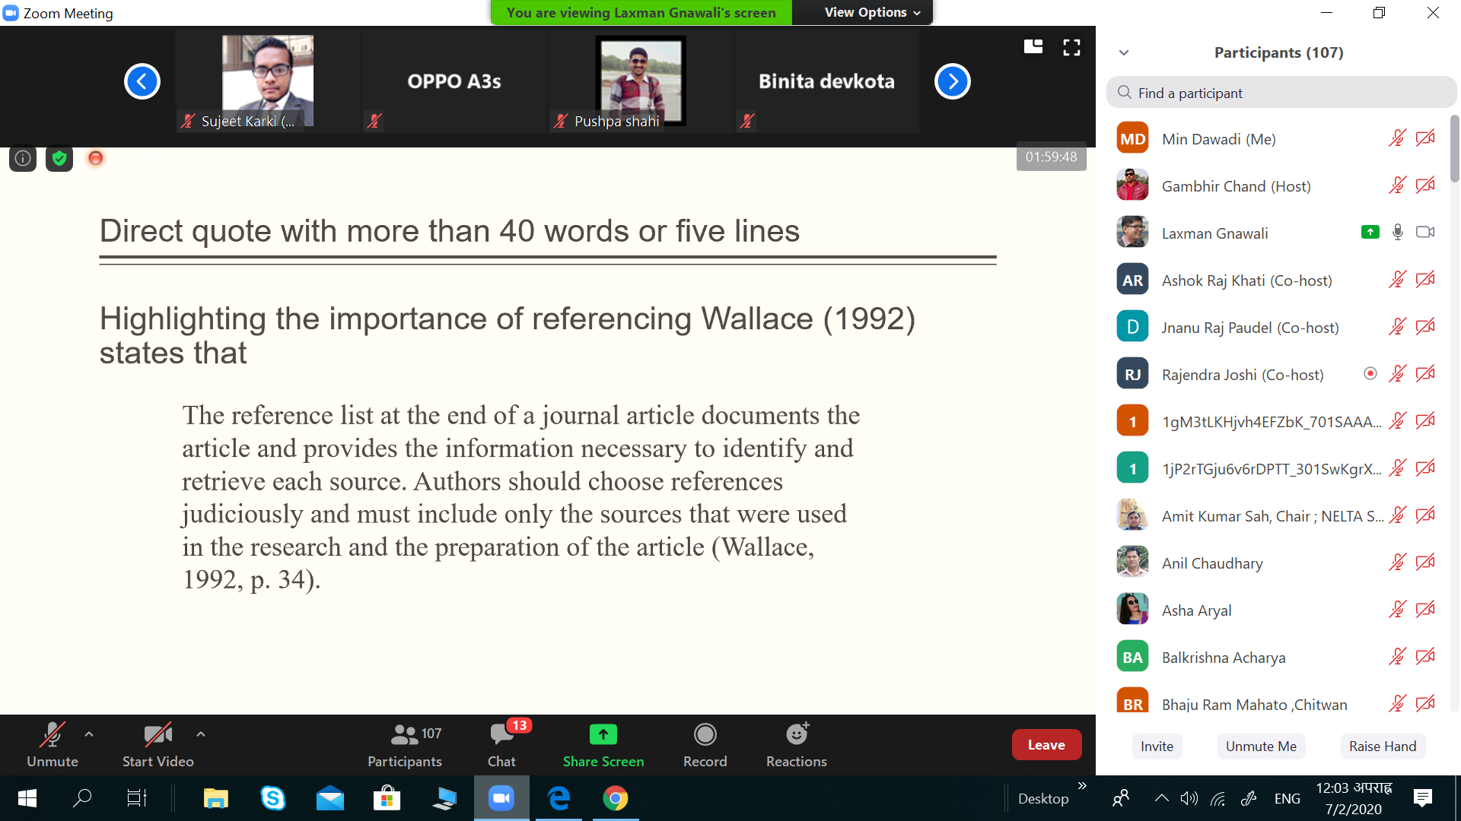

Slide 16
.
References: Example

Slide 17
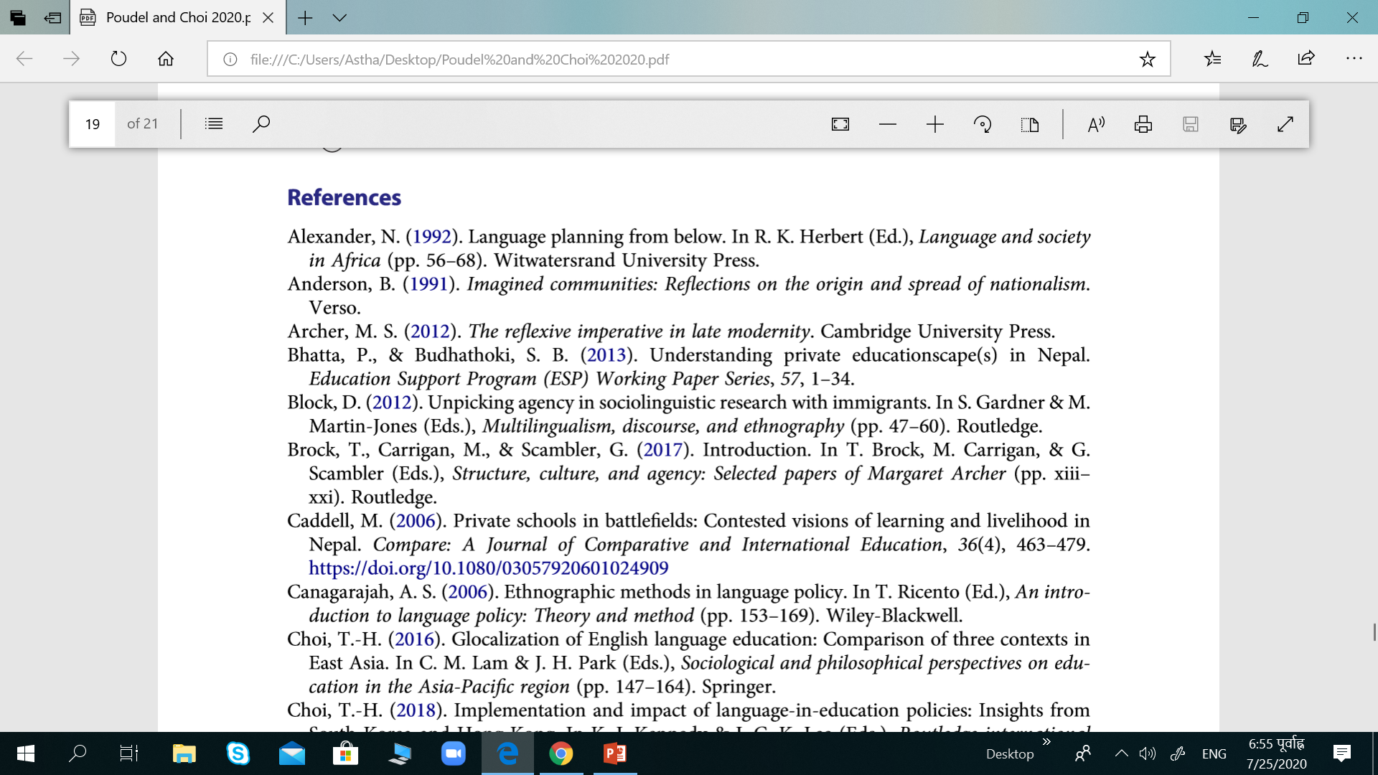

Slide 18
How is Ethics Related to Technical Communication?
Technical communication aims to educate and inform readers about how to operate a piece of equipment or a software application.
Instead of rehearsing already known facts, technical communication shows readers how to do or how to understand things in a new way.
When a technical writer produces a report/manual for an organization, the organization owns the copyright to what is written.

Slide 19
…
One area of ethical choice involves how to give credit to others’ work.
Copyright symbols, trademark symbols, and referencing systems (APA, MLA) are some of the ways writers give credit to others.
As a technical writer it's crucial to understand and use symbols and referencing systems correctly to be free from plagiarism.

Slide 20
Copyright, Trademarks and Patents
Copyright refers to the right to copy or reproduce original works yourself and the right to assign permission to make copies to others.
This right applies to the original works of literature, film, music, photographs, art etc.
You should label your own work with your (or your organization’s) name, the year in which the work was first published, and the copyright symbol: ©.
Copyright protected work can be copied legally with the permission of the copyright holder.

Slide 21
..
Trademarks refer to items that establish a brand: slogans, product names, packaging, and symbols.
As a technical writer, you may often refer to trademarks owned by your company or other products that interact with you.
Patents are used to protect inventions such as new manufacturing products and processes.

Slide 22
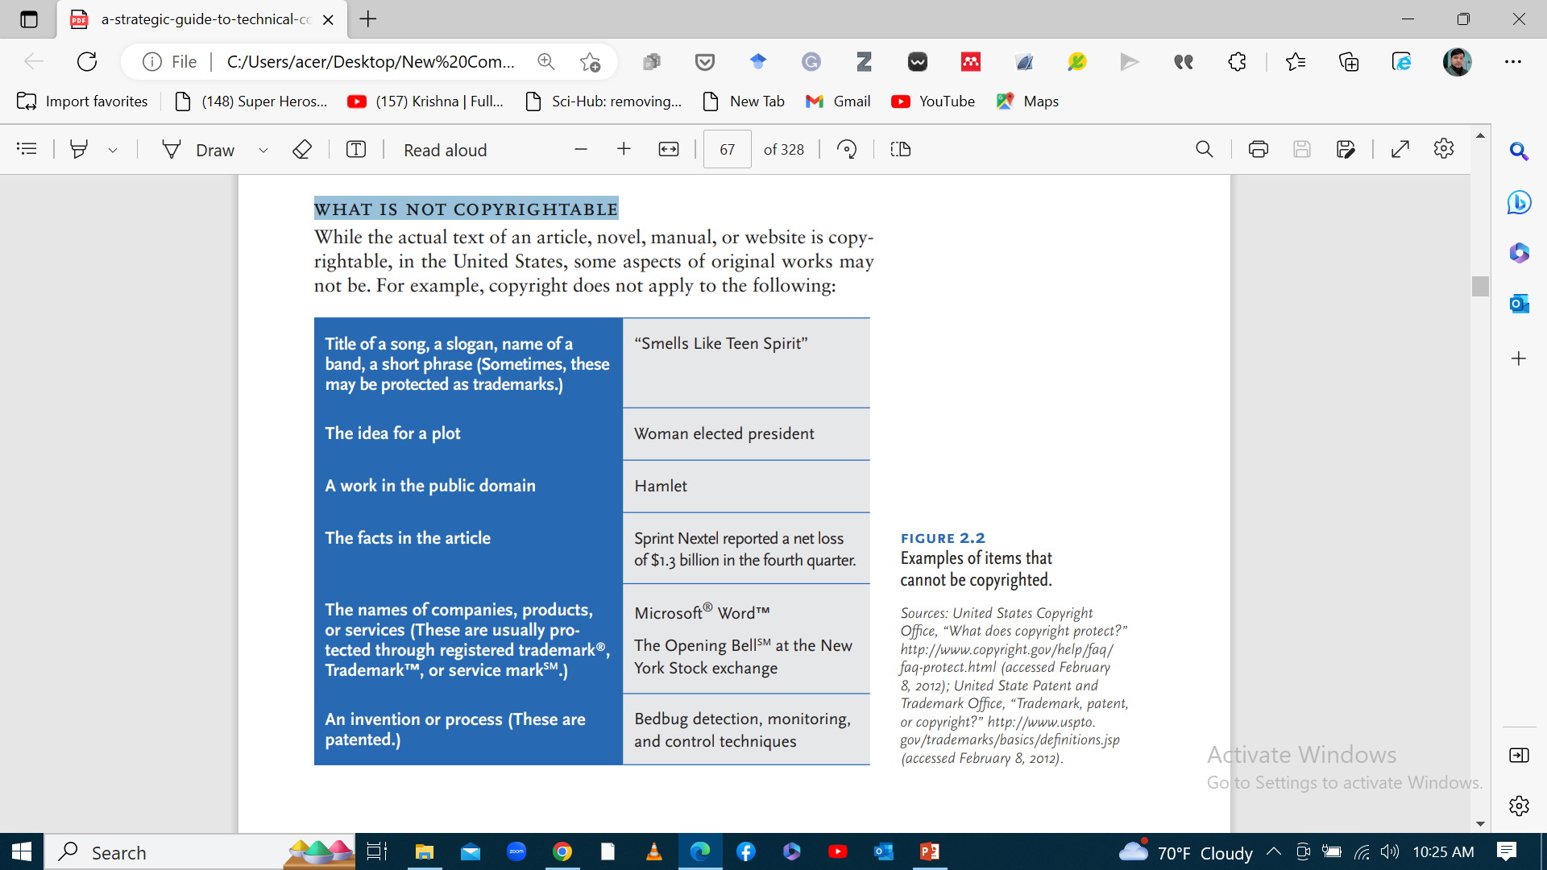
What is not copyrightable?

Slide 23
Writing Ethically
Writers should strive for clarity in writing.
However, there are legitimate situations that hinders to be clear: Eg; bad news should be delivered with a sort of buffer statement.
It would be cruel to simply walk up to someone and announce that he/she was fired or failed a test or to tell bluntly that a family member died.

Slide 24
..
In various scenarios, organizations hide the truth by using vague wording and understatements to hide crucial details.
Plain language laws and creativities come as a solution to this kind of strategically unclear language use.
Plain language: use concise sentences with clear and simple terms that readers can quickly grasp.

Slide 25
Plain language Guidelines
Plain language holds an ethical relationship between reader and writer.
Take up their point of view and write “reader-based prose” or prose that is organized around what the reader needs to know.
Consider the following questions:
What level of knowledge do they have?
What is their cultural background?
What is their income level?
What do they want to know?
What information will they use most frequently?
What questions are they asking about the topic you are writing about?

Slide 26
Chapter -3 Researching Technical Subjects-
Research literally means to search again to find out something new and more about a phenomenon.
Your main source of information people/books, so it is necessary to expand your range of research skills using methods as interviewing and surveying.
There are primary and secondary sources of collecting data for research.

Slide 27
Three GENERAL steps of research
  Pose a question.
  Collect data
  Present an answer to the question.

Slide 28
Primary Research: Interviewing
For technical communicators documenting a new product or system, a key information source is the developers themselves.
Data is gathered through interviews with individuals, who are asked specific questions about the product or system.
The information obtained is used to create the operation or reference manual.
There are three stages to completing a successful interview:
Preparing for it
Conducting it
Writing it up

Slide 29
Preparing for the interview
Prepare yourself in the following areas:
Learn in advance about the subject to be discussed with the subject matter expert.
Learn in advance about the subject matter expert.
Prepare a list of well-organized questions.

Slide 30
Prepare a list of organized questions
Organize ahead.
Create a legible/readable, numbered list.
Structure the questions to control the interview.
Write some extra questions.

Slide 31
Writing good questions
Ask about topics that you don’t understand.
Include detail and background to your questions to provide context.

Slide 32
Conducting the Interview
Schedule an hour-long interview, if possible.
Introduce yourself and explain your project.
Decide whether to record the interview.
Be an active listener.
Control the interview.

Slide 33
Closing the Interview
Thank your interviewee for their time and clearly express that their answers have supplied valuable information.
Ensure your subject expert addresses any follow-up questions that may arise during your note review or converting responses into written text.
As soon as you can, review your notes and fill out any gaps that you see with details.
Assess how well the received answers will be sufficient for required information.

Slide 34
Primary research: Conducting surveys
Survey research is a method of generating information by asking questions to a group of people.
Survey research can help you at two stages in your writing project: before you begin writing and as part of usability testing (revising).
In the initial stages of writing project, you could do surveys to find out what users are looking for in a manual.

Slide 35
Asking good questions
Survey research is a method of generating information by asking questions to a group of people.
The quality of your survey is directly related to your skill at asking good questions.
There are two main types of questions to ask: closed-ended and open-ended.
Closed-ended questions have the range of possible answers printed below the question itself; these questions are said to be closed because the range of answer is predetermined.

Slide 36
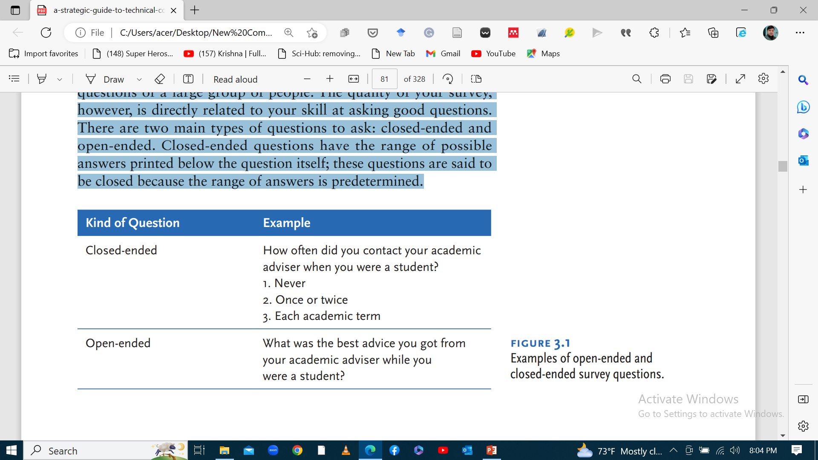

Slide 37
Guidelines for asking good questions
Rephrase jargon and technical language into plain language.
Ask specific questions.
Avoid loaded questions.
Break compound questions into individual questions.

Slide 38
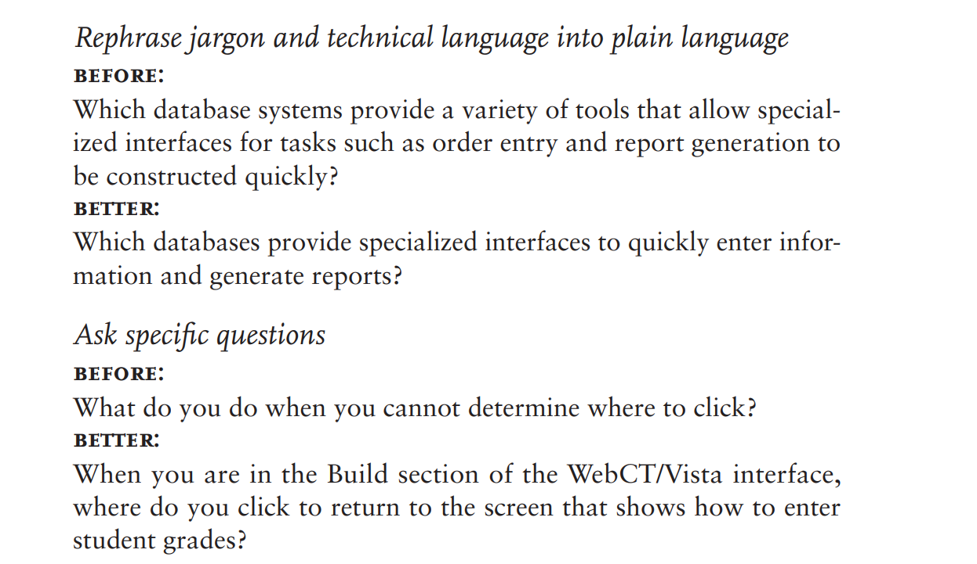
Examples

Slide 39
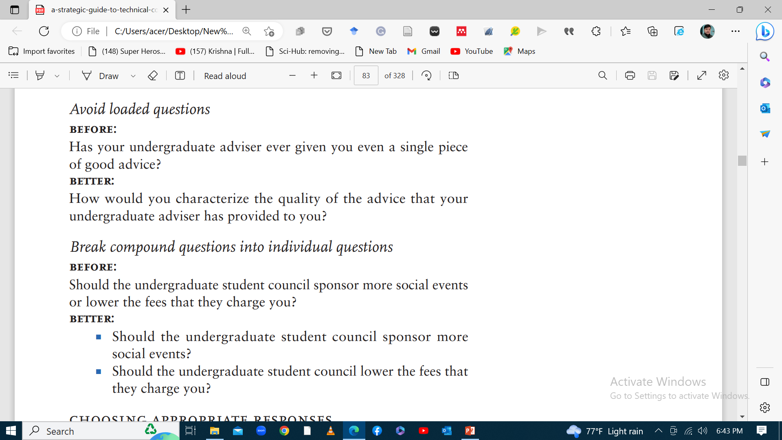

Slide 40
Choosing appropriate responses
Asking good questions is one half of the challenge when you write questions. The other half is creating appropriate responses.
Open-ended questions do not provide a structured response by the very nature of these questions.
Responses to closed ended questions can take the following forms:
Yes/no answers
Rating scales
Comparative rating scales
Category scales

Slide 41
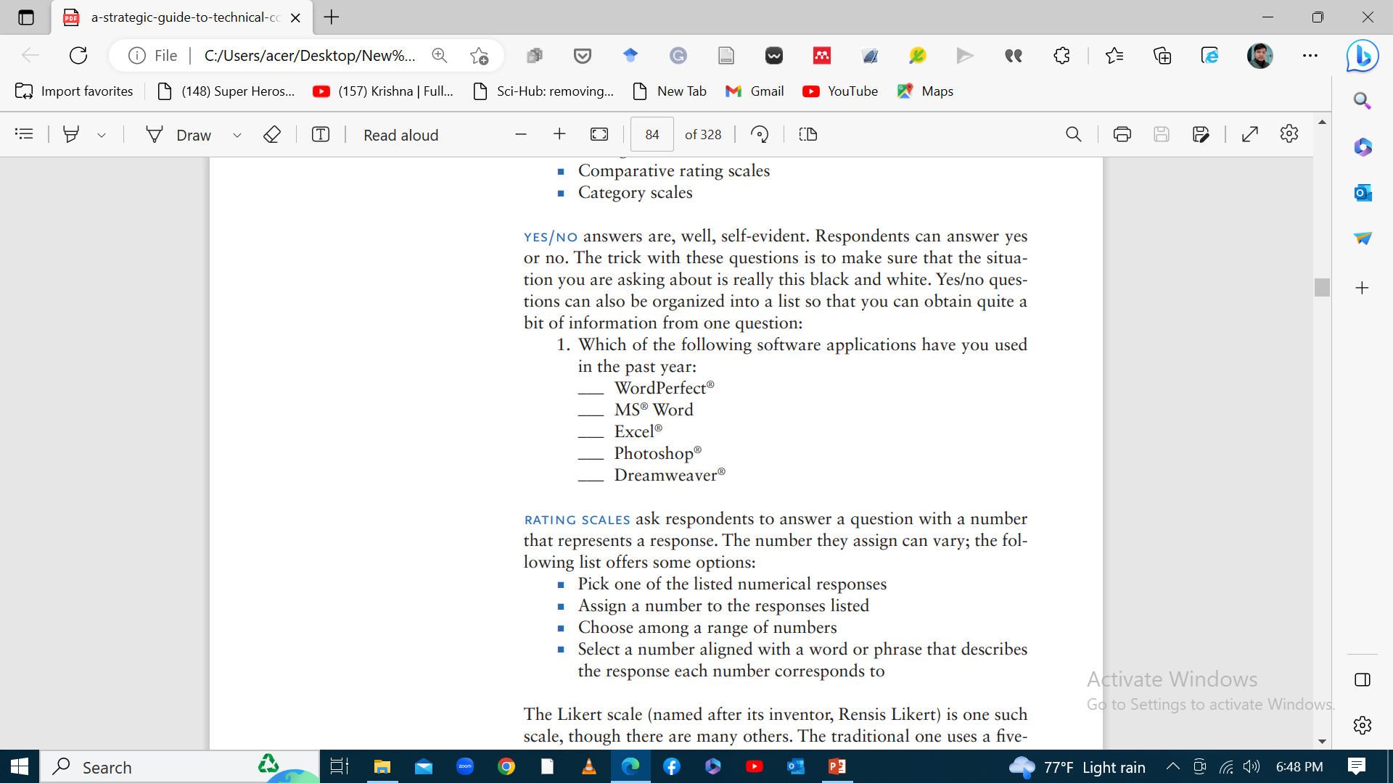
Examples

Slide 42
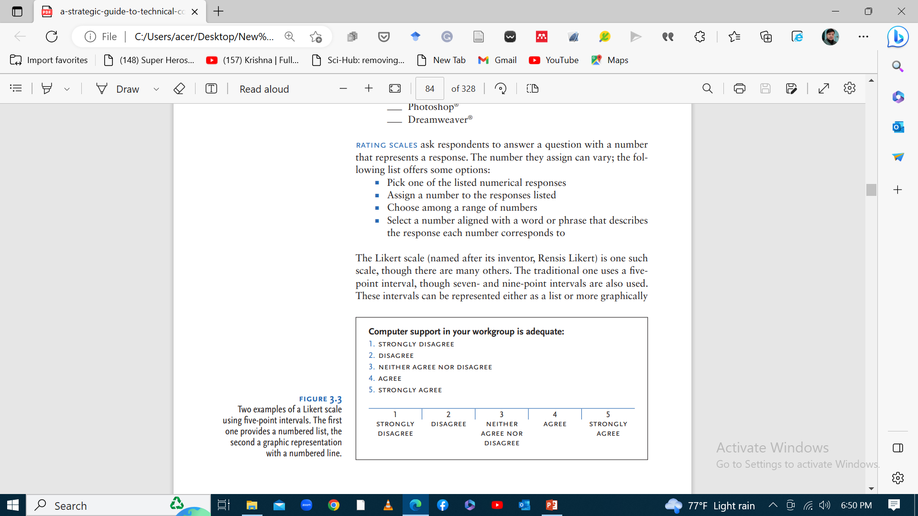

Slide 43
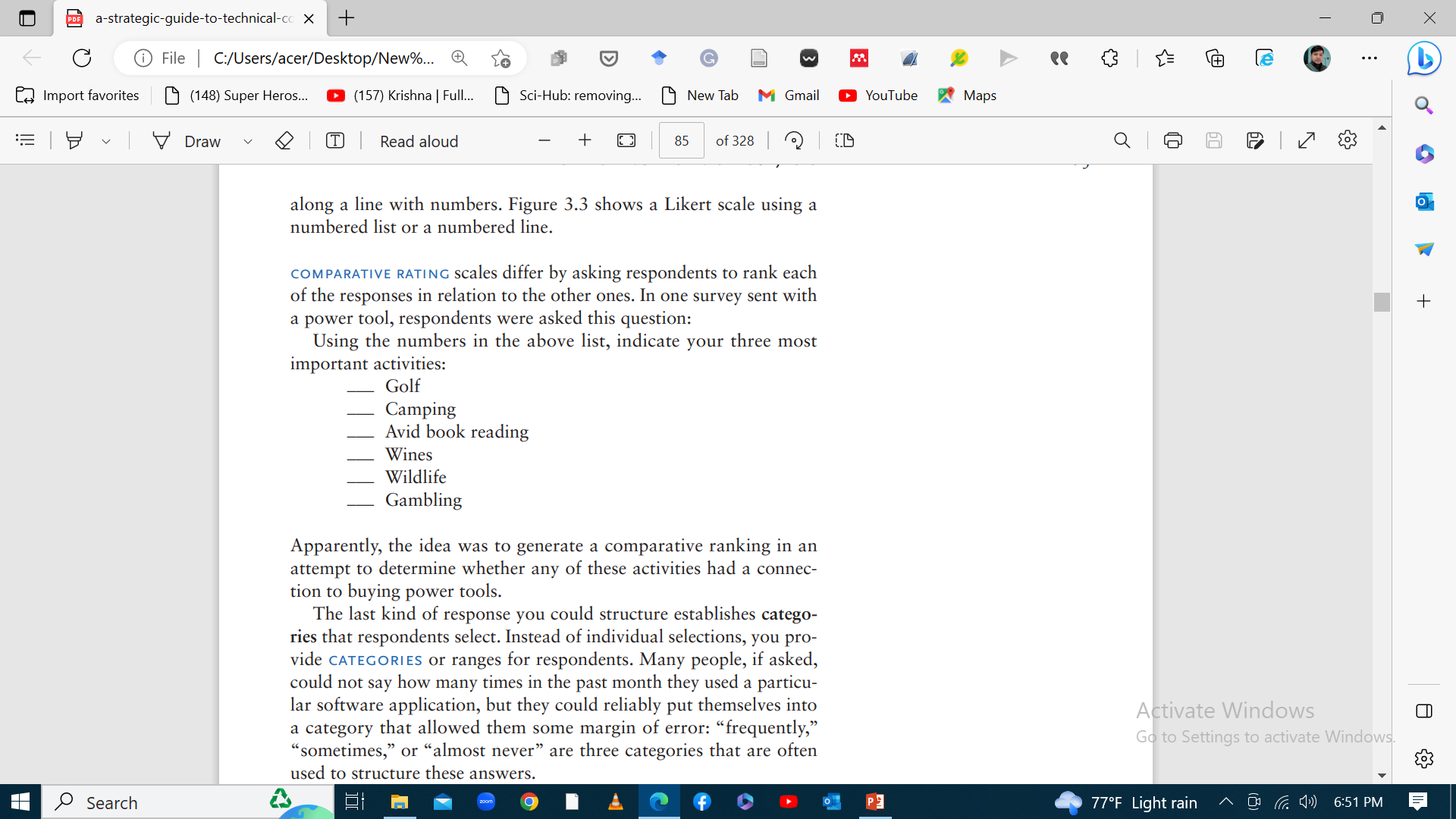

Slide 44
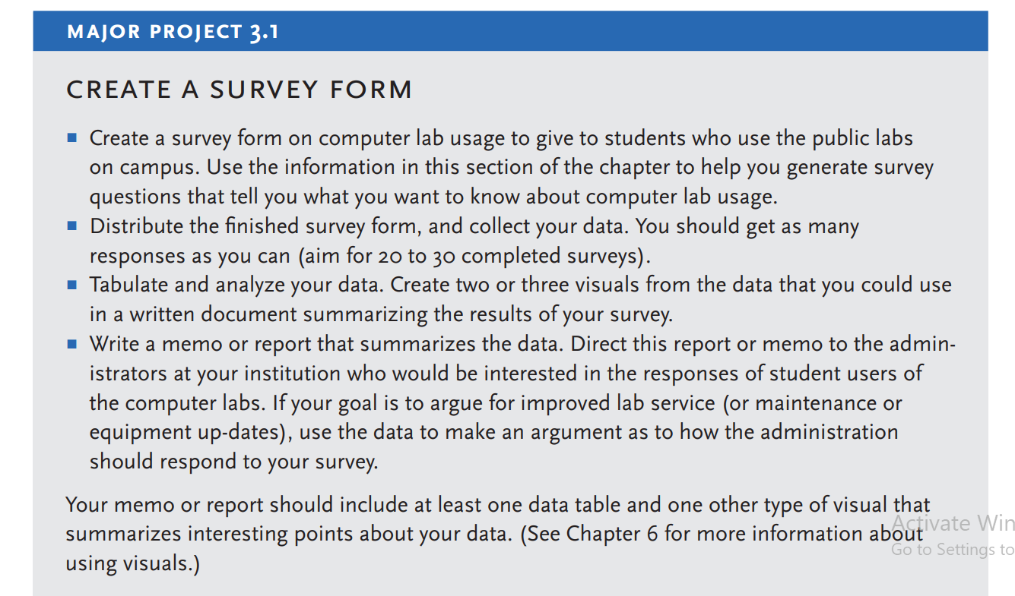

Slide 45
Secondary Research: Finding print and online sources
Depending upon what type of technical document you are writing, you may need to do some library or print research on your subject.
Writing a laboratory report based on a series of experiments, need to investigate further research on aspects related to the topic of experiments.
If you are creating a software manual to fill a market function, you might examine recently published existing manuals to pick up some strategies or tips about what to do or not to do.

Slide 46
..
If you are writing a white paper on a new electronic device, you might visit the Internet to search for competitors’ products that you can use as a comparison with your company’s device.
Examples of well-written white papers about similar devices that may work as model, or consumer chat sites that evaluate and comment on similar products that may give you useful perspectives on what your readers may like or dislike about such items.

Slide 47
..
Libraries are better stocked with useful sources and information.
Many of the technical communication journals have their online issues , and many educational collections carry these contributions.
You can search full-text article from your computer and download a pdf to read on screen or to print off a paper copy.

Slide 48
Conducting an effective search for sources: Library and internet
Finding useful information depends on the keywords that you select to use in your search.
To improve the chances to name your subject matter correctly in the search, generate a list of words that you associate with the topic.
List as many synonyms for each word as you can think of.
A subject directory can help you think of subcategories related to your broader topic.
You can also browse or use keyword searches at the library.

Slide 49
…
To narrow your search, combine two or three key words to focus and qualify the sources that show up on your screen.
You may narrow your search by specifying what you don’t want.
Librarians can shortcut your search time by directing you to the right subject headings, and by pointing out the location of various types of sources.

Slide 50
Assessing the credibility of your sources
1. Publisher
2. Author
3. Currency
4. Evidence
5. Slant/ viewpoint

Slide 51
Citing and paraphrasing researched sources
When you encounter a phrase, sentence, or paragraph written by someone else what you would like to repeat it exactly, you should quote it.
Quotation means copy the passage word for word, and place it between quotation marks or if it is longer than four lines, set it off in a block quotation.
Note that the long passage is indented to the right and the shorter phrases are contained in quotation marks.
It is important to cite sources, to tell where a quotation came from.

Slide 52
Types of information that you should document:
Statements of opinion
Claims that can be argued
Sources for statistics
Research findings
Examples
Graphs
Charts
Illustrations

